Slide 1

The One-to-Many Relationship
Cow of many-well milked and badly fed
Spanish proverb

Slide 2
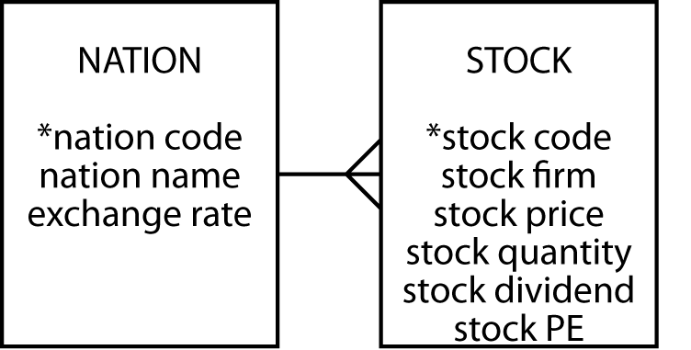
The one-to-many relationship
Entities are related to other entities
A 1:m relationship

Slide 3
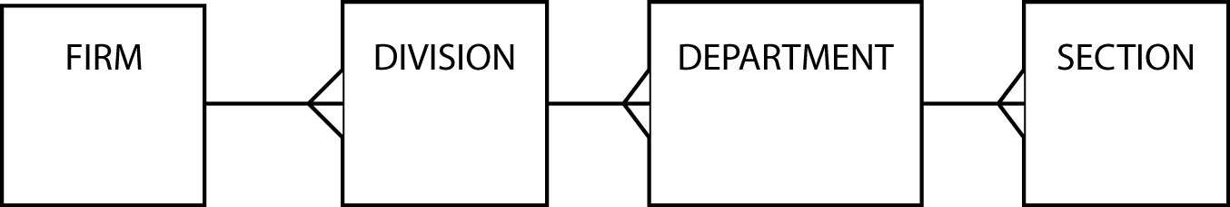
Hierarchical relationships
Occur frequently
Multiple 1:m relationships

Slide 4
Create another entity to avoid update anomalies
Insert
Delete
Update

Slide 5
STOCK with additional columns
stock
stkcode | stkfirm | stkprice | stkqty | stkdiv | stkpe | natname | exchrate
FC | Freedonia Copper | 27.50 | 10529 | 1.84 | 16 | United Kingdom | 1.00
PT | Patagonian Tea | 55.25 | 12635 | 2.50 | 10 | United Kingdom | 1.00
AR | Abyssinian Ruby | 31.82 | 22010 | 1.32 | 13 | United Kingdom | 1.00
SLG | Sri Lankan Gold | 50.37 | 32868 | 2.68 | 16 | United Kingdom | 1.00
ILZ | Indian Lead &Zinc | 37.75 | 6390 | 3.00 | 12 | United Kingdom | 1.00
BE | Burmese Elephant | .07 | 154713 | 0.01 | 3 | United Kingdom | 1.00
BS | Bolivian Sheep | 12.75 | 231678 | 1.78 | 11 | United Kingdom | 1.00
NG | Nigerian Geese | 35.00 | 12323 | 1.68 | 10 | United Kingdom | 1.00
CS | Canadian Sugar | 52.78 | 4716 | 2.50 | 15 | United Kingdom | 1.00
ROF | Royal Ostrich Farms | 33.75 | 1234923 | 3.00 | 6 | United Kingdom | 1.00
MG | Minnesota Gold | 53.87 | 816122 | 1.00 | 25 | USA | 0.67
GP | Georgia Peach | 2.35 | 387333 | .20 | 5 | USA | 0.67
NE | Narembeen Emu | 12.34 | 45619 | 1.00 | 8 | Australia | 0.46
QD | Queensland Diamond | 6.73 | 89251 | .50 | 7 | Australia | 0.46
IR | Indooroopilly Ruby | 15.92 | 56147 | .50 | 20 | Australia | 0.46
BD | Bombay Duck | 25.55 | 167382 | 1.00 | 12 | India | 0.0228

Slide 6
Mapping to a relational database
Each entity becomes a table
The entity name becomes the table name
Each attribute becomes a column
Add a column to the table at the many end of a 1:m relationship
Put the identifier of the one end in the added column

Slide 7
NATION and STOCK
nation
natcode | natname | exchrate
UK | United Kingdom | 1.00
USA | United States | 0.67
AUS | Australia | 0.46
IND | India | 0.0228
stock
stkcode | stkfirm | stkprice | stkqty | stkdiv | stkpe | natcode
FC | Freedonia Copper | 27.50 | 10529 | 1.84 | 16 | UK
PT | Patagonian Tea | 55.25 | 12635 | 2.50 | 10 | UK
AR | Abyssinian Ruby | 31.82 | 22010 | 1.32 | 13 | UK
SLG | Sri Lankan Gold | 50.37 | 32868 | 2.68 | 16 | UK
ILZ | Indian Lead &Zinc | 37.75 | 6390 | 3.00 | 12 | UK
BE | Burmese Elephant | .07 | 154713 | 0.01 | 3 | UK
BS | Bolivian Sheep | 12.75 | 231678 | 1.78 | 11 | UK
NG | Nigerian Geese | 35.00 | 12323 | 1.68 | 10 | UK
CS | Canadian Sugar | 52.78 | 4716 | 2.50 | 15 | UK
ROF | Royal Ostrich Farms | 33.75 | 1234923 | 3.00 | 6 | UK
MG | Minnesota Gold | 53.87 | 816122 | 1.00 | 25 | USA
GP | Georgia Peach | 2.35 | 387333 | .20 | 5 | USA
NE | Narembeen Emu | 12.34 | 45619 | 1.00 | 8 | AUS
QD | Queensland Diamond | 6.73 | 89251 | .50 | 7 | AUS
IR | Indooroopilly Ruby | 15.92 | 56147 | .50 | 20 | AUS
BD | Bombay Duck | 25.55 | 167382 | 1.00 | 12 | IND

Slide 8
Foreign keys
A foreign key is a column that is a primary key of another table
  natcode in stock is a foreign key because natcode is the primary key of nation
Record a 1:m relationship

Slide 9
Referential integrity constraint
For every value of a foreign key there is a primary key with that value
For every value of natcode in stock there is a value of natcode in nation
A foreign key can never be null
A primary key must exist before the foreign key can be defined
  Must create the nation before its stocks

Slide 10
Creating the tables
CREATE TABLE nation (
natcode CHAR(3),
natname VARCHAR(20),
exchrate DECIMAL(9,5),
PRIMARY KEY (natcode));
CREATE TABLE stock (
stkcode CHAR(3),
stkfirm VARCHAR(20),
stkprice DECIMAL(6,2),
stkqty DECIMAL(8),
stkdiv DECIMAL(5,2),
stkpe DECIMAL(5),
natcode CHAR(3),
PRIMARY KEY(stkcode),
CONSTRAINT fk_has_nation FOREIGN KEY(natcode)
REFERENCES nation(natcode) ON DELETE RESTRICT);

Slide 11
Representing a 1:m relationship in MS Access

Slide 12
Join
Create a new table from two existing tables by matching on a common column
SELECT * FROM stock, nation
WHERE stock.natcode = nation.natcode;
stkcode | stkfirm | stkprice | stkqty | stkdiv | stkpe | natcode | natcode1 | natname | exchrate
NE | Narembeen Emu | 12.34 | 45619 | 1.00 | 8 | AUS | AUS | Australia | 0.46000
IR | Indooroopilly Ruby | 15.92 | 56147 | 0.50 | 20 | AUS | AUS | Australia | 0.46000
QD | Queensland Diamond | 6.73 | 89251 | 0.50 | 7 | AUS | AUS | Australia | 0.46000
BD | Bombay Duck | 25.55 | 167382 | 1.00 | 12 | IND | IND | India | 0.02280
ROF | Royal Ostrich Farms | 33.75 | 1234923 | 3.00 | 6 | UK | UK | United Kingdom | 1.00000
CS | Canadian Sugar | 52.78 | 4716 | 2.50 | 15 | UK | UK | United Kingdom | 1.00000
FC | Freedonia Copper | 27.50 | 10529 | 1.84 | 16 | UK | UK | United Kingdom | 1.00000
BS | Bolivian Sheep | 12.75 | 231678 | 1.78 | 11 | UK | UK | United Kingdom | 1.00000
BE | Burmese Elephant | 0.07 | 154713 | 0.01 | 3 | UK | UK | United Kingdom | 1.00000
ILZ | Indian Lead & Zinc | 37.75 | 6390 | 3.00 | 12 | UK | UK | United Kingdom | 1.00000
SLG | Sri Lankan Gold | 50.37 | 32868 | 2.68 | 16 | UK | UK | United Kingdom | 1.00000
AR | Abyssinian Ruby | 31.82 | 22010 | 1.32 | 13 | UK | UK | United Kingdom | 1.00000
PT | Patagonian Tea | 55.25 | 12635 | 2.50 | 10 | UK | UK | United Kingdom | 1.00000
NG | Nigerian Geese | 35.00 | 12323 | 1.68 | 10 | UK | UK | United Kingdom | 1.00000
MG | Minnesota Gold | 53.87 | 816122 | 1.00 | 25 | US | US | United States | 0.67000
GP | Georgia Peach | 2.35 | 387333 | 0.20 | 5 | US | US | United States | 0.67000

Slide 13
Join
Report the value of each stock holding in UK pounds. Sort the report by nation and firm.
SELECT natname, stkfirm, stkprice, stkqty, exchrate,
stkprice*stkqty*exchrate AS stkvalue
FROM stock,nation
WHERE stock.natcode = nation.natcode
ORDER BY natname, stkfirm;
natname | stkfirm | stkprice | stkqty | exchrate | stkvalue
Australia | Indooroopilly Ruby | 15.92 | 56147 | 0.46000 | 411175.71
Australia | Narembeen Emu | 12.34 | 45619 | 0.46000 | 258951.69
Australia | Queensland Diamond | 6.73 | 89251 | 0.46000 | 276303.25
India | Bombay Duck | 25.55 | 167382 | 0.02280 | 97506.71
United Kingdom | Abyssinian Ruby | 31.82 | 22010 | 1.00000 | 700358.20
United Kingdom | Bolivian Sheep | 12.75 | 231678 | 1.00000 | 2953894.50
United Kingdom | Burmese Elephant | 0.07 | 154713 | 1.00000 | 10829.91
United Kingdom | Canadian Sugar | 52.78 | 4716 | 1.00000 | 248910.48
United Kingdom | Freedonia Copper | 27.50 | 10529 | 1.00000 | 289547.50
United Kingdom | Indian Lead & Zinc | 37.75 | 6390 | 1.00000 | 241222.50
United Kingdom | Nigerian Geese | 35.00 | 12323 | 1.00000 | 431305.00
United Kingdom | Patagonian Tea | 55.25 | 12635 | 1.00000 | 698083.75
United Kingdom | Royal Ostrich Farms | 33.75 | 1234923 | 1.00000 | 41678651.25
United Kingdom | Sri Lankan Gold | 50.37 | 32868 | 1.00000 | 1655561.16
United States | Georgia Peach | 2.35 | 387333 | 0.67000 | 609855.81
United States | Minnesota Gold | 53.87 | 816122 | 0.67000 | 29456209.73

Slide 14
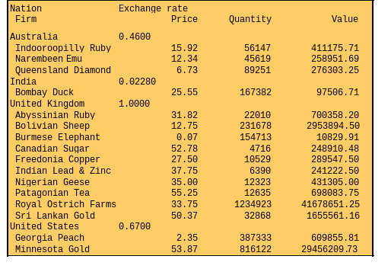
Control break reporting

Slide 15
GROUP BY - reporting by groups
Report by nation the total value of stockholdings.
SELECT natname, SUM(stkprice*stkqty*exchrate) AS stkvalue
FROM stock, nation WHERE stock.natcode = nation.natcode
GROUP BY natname;
natname | stkvalue
Australia | 946430.65
India | 97506.71
United Kingdom | 48908364.25
United States | 30066065.54

Slide 16
HAVING - the WHERE clause of groups
Report the total value of stocks for nations with two or more listed stocks.
SELECT natname, SUM(stkprice*stkqty*exchrate) AS stkvalue
FROM stock, nation WHERE stock.natcode = nation.natcode
GROUP BY natname
HAVING COUNT(*) >= 2;
natname | stkvalue
Australia | 946430.65
United Kingdom | 48908364.25
United States | 30066065.54

Slide 17
Subqueries
A query nested within another query
Report the names of all Australian stocks.
SELECT stkfirm FROM stock
WHERE natcode IN
(SELECT natcode FROM nation
WHERE natname = 'Australia');
stkfirm
Narembeen Emu
Queensland Diamond
Indooroopilly Ruby

Slide 18
Correlated subquery
Solves the inner query many times
Find those stocks where the quantity is greater than the average for that country.
SELECT natname, stkfirm, stkqty FROM stock, nation
WHERE stock.natcode = nation.natcode
AND stkqty >
(SELECT AVG(stkqty) FROM stock
WHERE stock.natcode = nation.natcode);
natname | stkfirm | stkqty
Australia | Queensland Diamond | 89251
United Kingdom | Bolivian Sheep | 231678
United Kingdom | Royal Ostrich Farms | 1234923
United States | Minnesota Gold | 816122

Slide 19
Views - virtual tables
An imaginary table constructed by the DBMS when required
Only the definition of the view is stored, not the result
CREATE VIEW stkvalue
(nation, firm, price, qty, exchrate, value)
AS SELECT natname, stkfirm, stkprice, stkqty, exchrate,
stkprice*stkqty*exchrate
FROM stock, nation
WHERE stock.natcode = nation.natcode;
Notes:
Added to MySQL 5.0.1

Slide 20
Views - querying
Query exactly as if a table
SELECT nation, firm FROM stkvalue WHERE value > 100000;
nation | firm | value
Australia | Narembeen Emu
Australia | Indooroopilly Ruby
Australia | Queensland Diamond
United Kingdom | Royal Ostrich Farms
United Kingdom | Canadian Sugar
United Kingdom | Freedonia Copper
United Kingdom | Bolivian Sheep
United Kingdom | Indian Lead & Zinc
United Kingdom | Sri Lankan Gold
United Kingdom | Abyssinian Ruby
United Kingdom | Patagonian Tea
United Kingdom | Nigerian Geese
United States | Minnesota Gold
United States | Georgia Peach

Slide 21
Why create a view?
Simplify query writing
  Calculated columns
Restrict access to parts of a table

Slide 22
Summary
New topics
  1:m relationship
  Foreign key
  Correlated subquery
  GROUP BY
  HAVING clause
  View

